Slide 1
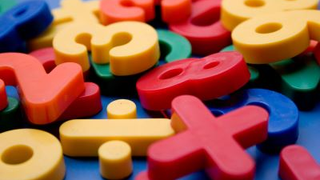
JavaScript Games for the intervention system
By: Megan Solomon, Nick Bobich, Andrejs Tomsons

Slide 2

Agenda
Background
Design Choices
Design
Implementation
Maintainability
Testing
Security
Summary

Slide 3

Background
Client: Dr. Larry Blackmer
Retired from educational background
Passion for helping students that are falling behind
Give teachers a new tool
Focusing on 5th grade mathematics
Topics will align with state standards

Slide 4
OUR Solution
Game Focus: Addition with Fractions
Game: Pizza Slicer
Features:
Visual approach
Hints
Scoring
Difficulty
Quiz

Slide 5
Design Choices
JavaScript
Phaser 3
GIMP
Texture Packer

Slide 6
DESIGN
Written in JavaScript
Phaser 3 2D Game Framework
Open source
Well documented
Beginner friendly
Simple structure

Slide 7
DESIGN
Sprites
Game objects
Scenes
Each “screen“ developed as a Phaser scene
Better code organization
Cleans memory and resources on execution
Easily switch through “screens”
GIMP
Texture Packer
Created buttons and images
Creates Sprite Sheets

Slide 8
DEMO
Main Menu
Quiz
Starting Page

Slide 9
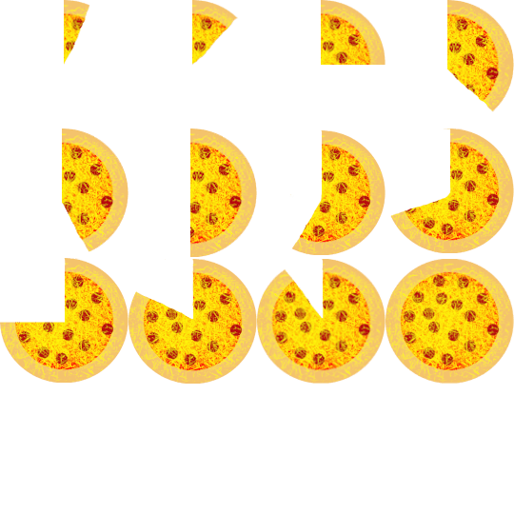
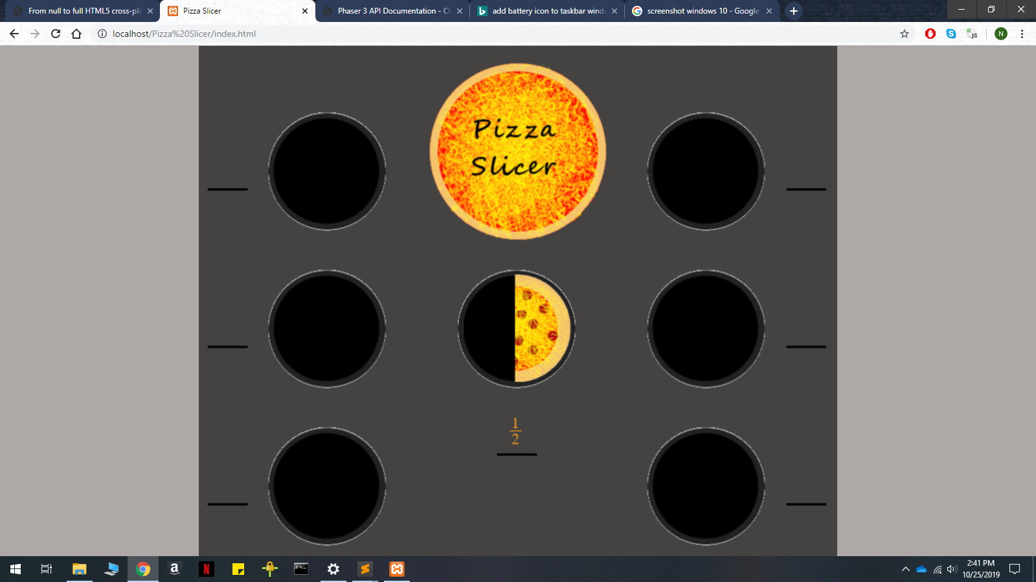
IMPLEMENTATION
Preloading Images
Sprite sheets increase efficiency
Calculations were easier
Zones
No need to load in a new image
Animation
Tweens

Slide 10
IMPLEMENTATION
Score
Score updates as student plays
Highest score is stored
Class leaderboard
Determining proficiency
Takes game score and converts it to a 1-10 number
508 Compliance
Color Blindness
Sounds won’t be important for game play

Slide 11
Maintenance
Documentation
Comments for each function
Include version number and dates
Well organized
Dr. Blackmer plans on assembling a team
Our game will be hosted within the systems database

Slide 12
Testing
Unit Testing
Difficult to create unit tests for games
Mocha
Usability Testing
We had relatives play our game to provide feedback
Performance Testing
Testing on different devices and browsers

Slide 13
Security
Database Protections
Cross-Site Scripting (XSS)
Cross-Site Request Forgery (CSRF)
SQL Injection
Hashed Password
Games without user input are less vulnerable

Slide 14
Summary
Our Goal
Create a game that is entertaining/educational
Reinforces a 5th grade math concept
Demonstrate that students improved
Pizza Slicer
Learn to add fractions with visual aid
Multiple modes and helpful hints
Scoring
Quiz

